Slide 1


Real Estate Price Prediction
Using Machine Learning to Predict Housing Valuations
A presentation by Brennan Bradley, Siobhan Curran, Ipsita Purohit
BCP, LLC
Notes:
Siobhan

Slide 2

Agenda:
Real Estate Price Prediction
What you can expect in today's presentation
Project Overview
Technical Aspects
User Interface
Tableau Dashboard
Ethical Considerations
Disclosures, References, and More
Notes:
Siobhan

Slide 3

Project Overview
This project, developed by BCP, LLC, aims to predict real estate prices in Florida using machine learning and a user-friendly web interface. It empowers users to make informed decisions through data-driven insights.
Notes:
Siobhan

Slide 4
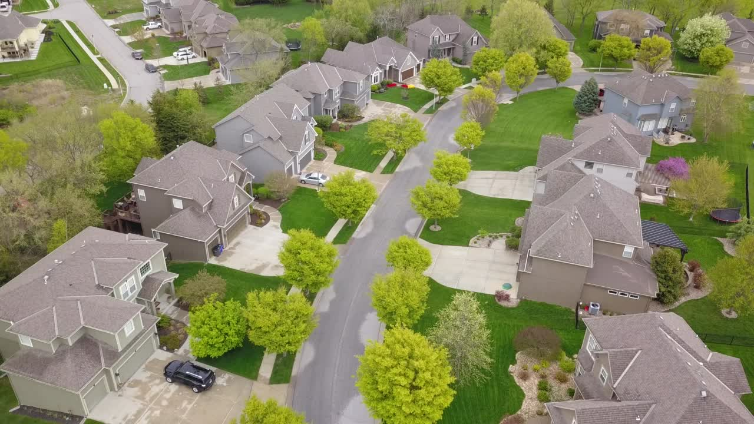
Purpose & Functionality
Purpose: Analyze sold housing market data to predict the cost of a home based on the user’s input of square footage, bedroom count, bathroom count, and city.
Data: Utilize Kaggle to obtain external data about the housing market in different locations (city, zip, etc) located within Florida. Data set includes bedroom count, bathroom count, square footage, and other details (data from 2022).
Visualization: Present the data in a user-friendly dashboard using HTML, CSS, and JavaScript.
Key Feature: Evaluate how previous data, combined with user selection, will translate into a property cost.
Charting: Employ the charting library Tableau to create a visual representation of trends within the housing industry.
Notes:
Siobhan

Slide 5
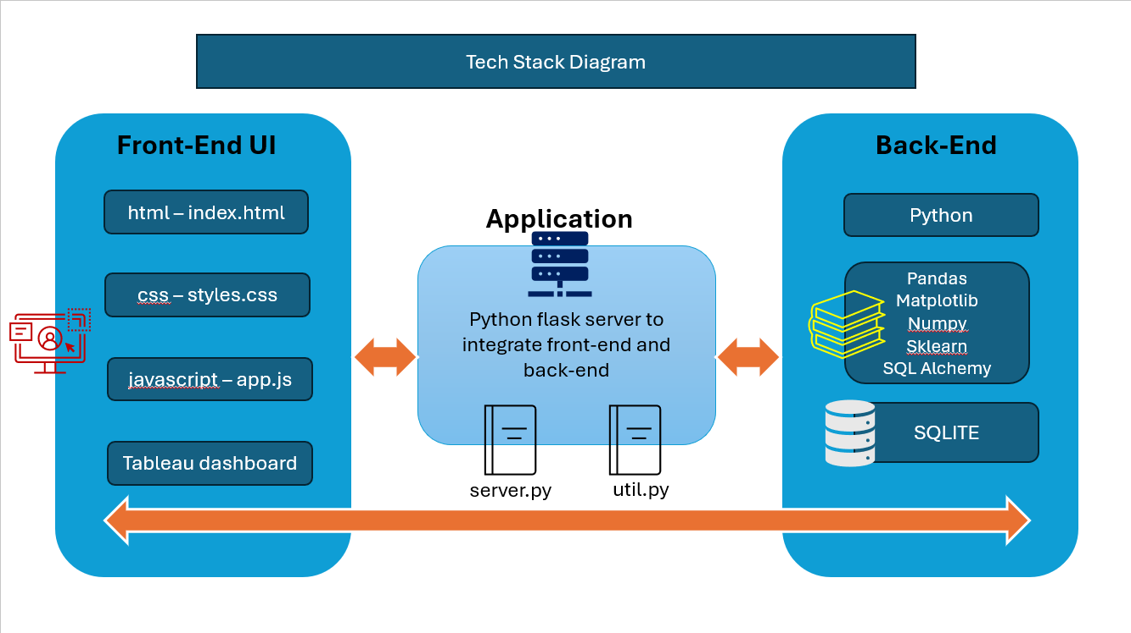
Notes:
Ipsita

Slide 6

Data Preparation & Cleansing
Data source:
Kaggle
Data clean-up & model building:
Load all real estate data from kaggle into SQLite
Delete data for all states other than FL
Remove column “state”
Remove all rows with null values for any record
Convert data types of the following columns into float:
Bed, Bath, Price, House size (square feet)
Remove rows with data points for city available < 10
Remove rows with number of bedrooms < 300
Filter out any data point beyond 1 standard deviation
Remove rows where number of bathrooms > number of bedrooms + 2
Covert city column into numerical values through one hot encoding through dummies function
Drop city column and build model using linear regression with 80% data used to train model and 20% to test
Export tested model to a pickle file and city and column information within JSON file
Notes:
Ipsita

Slide 7

Linear Regression
Linear regression is a machine learning technique used to predict a continuous target variable based on one or more input features by finding the best-fitting straight line or plane.
Our model imports the Linear Regression class from scikit-learn and creates a linear regression model instance. It then trains the model using training data and evaluates its performance by calculating the coefficient of determination (R^2 score) using testing data.
Y = mX + b, where Y is the response (dependent) variable, X is the predictor (independent) variable, m is the estimated slope, and b is the estimated intercept.
Notes:
Brennan

Slide 8
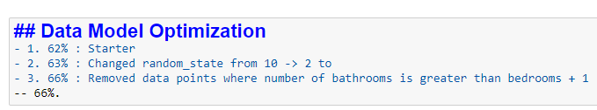
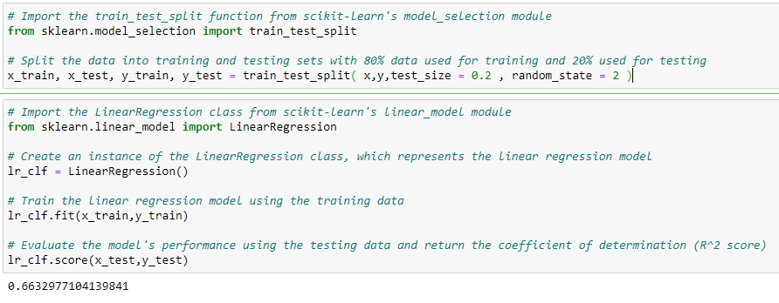
Data Model Optimization
We explored multiple avenues for how to improve our model. Ultimately, we didn’t document all of our outstanding findings, but will share just a few of the ideas we had in the above screenshot.
Before improving our model, we experienced a slight fall back when we tried to increase the accuracy of the model by increasing and decreasing bathroom count and bedroom count. Unfortunately, these adjustments resulted in a decrease in the accuracy from 65% to 63%.
After battling intrusive set backs such as this, we arrived at a conclusion and model accuracy of 66%. 3D Model takes >= 3 inputs.
Throughout the process we tested our model against historical data. We did that through:
Testing Function -> predict_home_price takes inputs such as location, number of bedrooms, bathrooms, and square footage to predict the price of a home. It checks if the location exists in the dataset's columns, sets its position to 1 if found, creates a feature array with input values, and predicts the home price using the trained linear regression model lr_clf. Finally, it returns the predicted price.
We then explored historical data through our tableau dashboard.
Notes:
Brennan -
We also explored other learning models like

Slide 9

Why Real Estate Price Prediction?
We chose real estate price prediction for several reasons
Relevance
By providing accessible and interactive data, we enable users to make well-informed decisions regarding their future in real estate.
It directly impacts many people, including those in our class considering buying a home.
Learning Opportunity
It provides a practical application of machine learning for a real-world problem.
Actionable Insights
Leveraging a team member's background in real estate, we aimed to create an interactive tool and clear visualizations simplify complex data, helping users understand their needs and the impact of features on price.
Personalized Exploration
Users can delve deeper with an interactive dashboard and customizable filters to compare housing options based on their priorities.

Slide 10
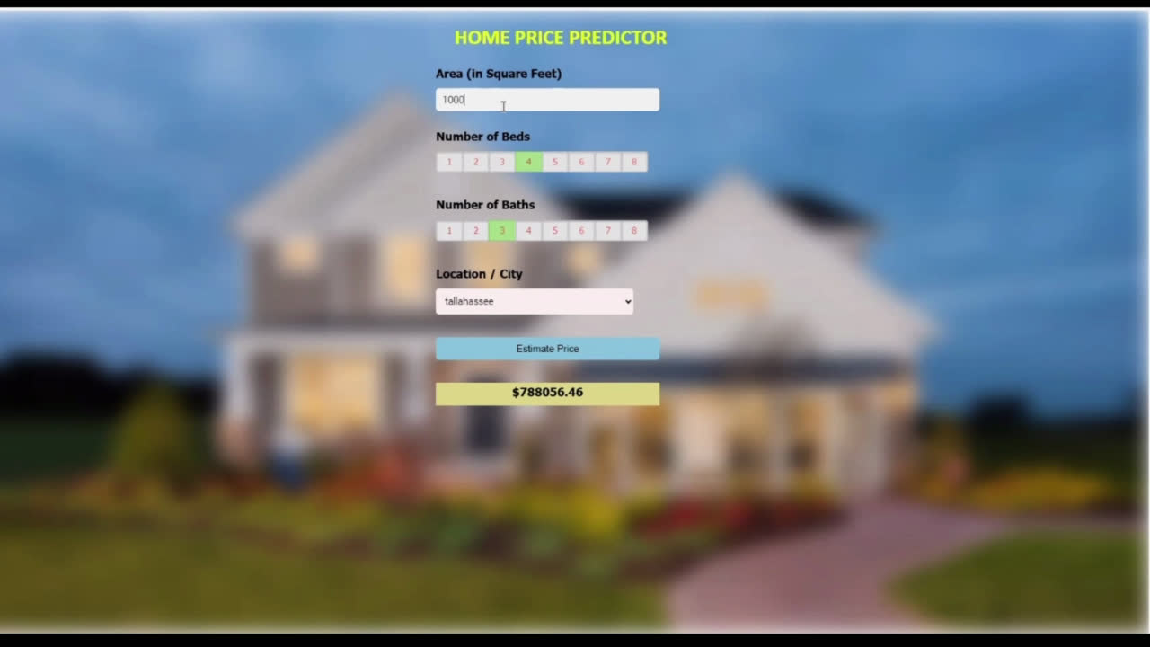
User Interface - Example 1
Notes:
Siobhan to speak & Ipsita to drive

Slide 11
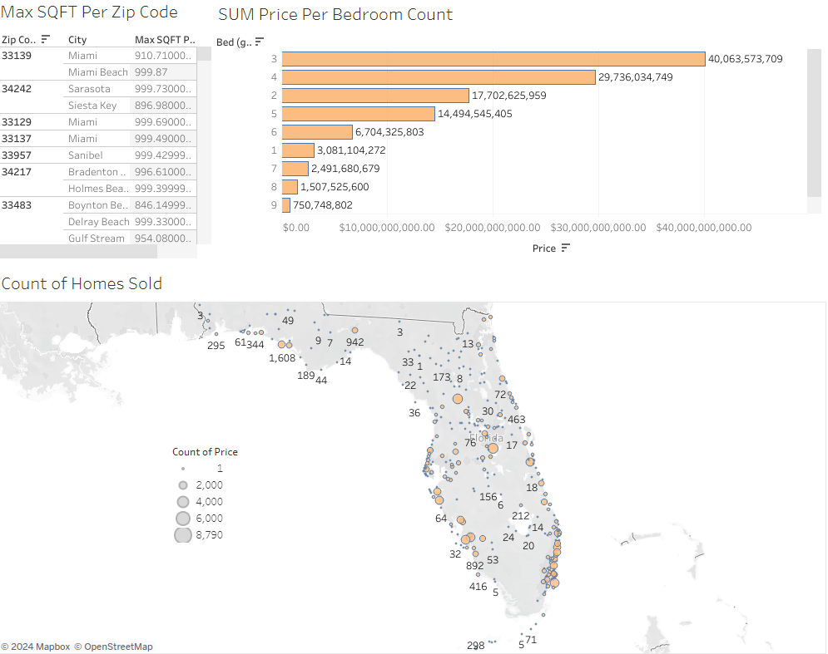
Tableau
Our dashboard can be located at:
https://public.tableau.com/app/profile/brennan.bradley/viz/Project_4_Dash/MainDashboard
Features include:
Dynamic Filters
Specific to FL
Location Analyses
User Friendly
Notes:
Brennan - he will share screen & talk

Slide 12


Ethical Considerations
Predicting real estate prices using machine learning can be a powerful tool, but it's critical to consider the ethical implications.
Data Bias:
We acknowledge potential biases in the data (e.g., historical trends) and strive to mitigate them through data cleaning.
Model Transparency:
We use an interpretable model (e.g., linear regression) to understand factors influencing predictions and avoid "black box" models.

Slide 13
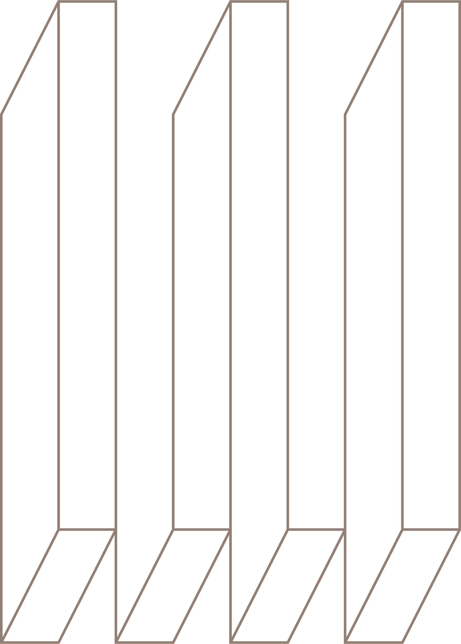
Our simulations are for educational purposes only and should not be considered financial or real estate advice. Users should consider other factors like property condition, market trends, and professional appraisals as predictions are estimates and do not replace professional expertise.
Disclosure & Disclaimer Statement
External resources were used in this project, including, but not limited to: Chat Bots/AI (Bard, ChatGPT, etc), tutors, external websites & videos(youtube), Canva, Click-Up, etc.
All images used are either available for free use and/or property of Canva and may not be reproduced. No pictures of copyrighted content was obtained from the internet, other than disclosed.
We acknowledge that past performance doesn't guarantee future result.

Slide 14

Links & Resources
GitHub - Brennan Bradley
GitHub - Siobhan Curran
GitHub - Ipsita Purohit
https://github.com/BrennanB572
https://github.com/Siobhan-C
https://github.com/ipsitapurohit
Tableau
Kaggle
https://public.tableau.com/app/profile/brennan.bradley/viz/Project_4_Dash/MainDashboard
https://www.kaggle.com/datasets/ahmedshahriarsakib/usa-real-estate-dataset/data

Slide 15
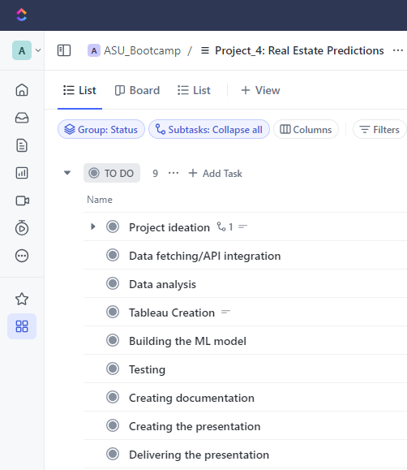
Click-up
Our team used Click-upfor as a project management tool
(https://app.clickup.com)

Slide 16


Questions?
Comments?
Thank you for attending our presentation.
BCP, LLC:
Bradley, Brennan
Curran, Siobhan
Purohit, Ipsita
ASU Data Analytics Bootcamp -
Project 4
06/10/2024

